Slide 1
Basic visualization using tableau

Slide 2

TABLAEU Why Visualize
To record information

Slide 3

Why Visualize
To point out interesting things

Slide 4

Why Visualize
To point out interesting things

Slide 5
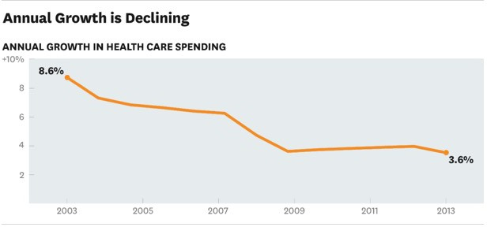
Why Visualize
To communicate information

Slide 6
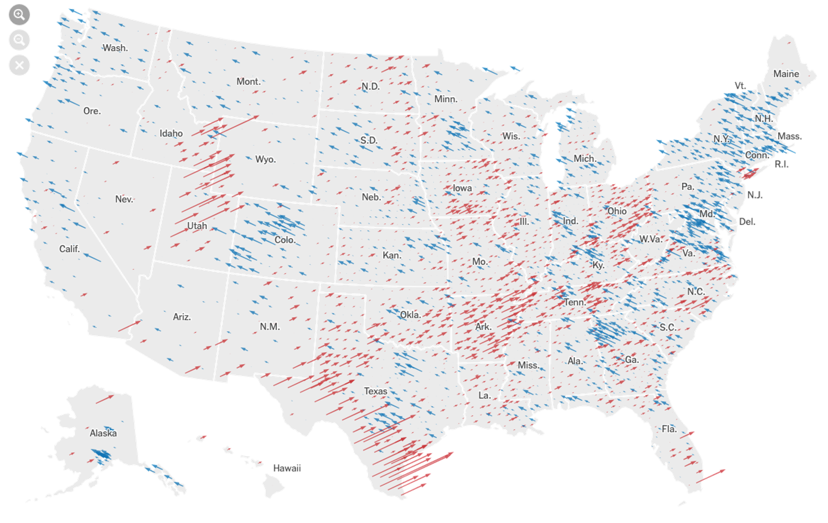
Why Visualize
To analyze data
2020 US Elections (NYTimes)

Slide 7
Why Visualize
To analyze data
2020 US Elections (NYTimes)

Slide 8
Tableau Workflow
Connect
Analyze
Share
Data source
Visualize data in Workspace
Dashboard or Story

Slide 9
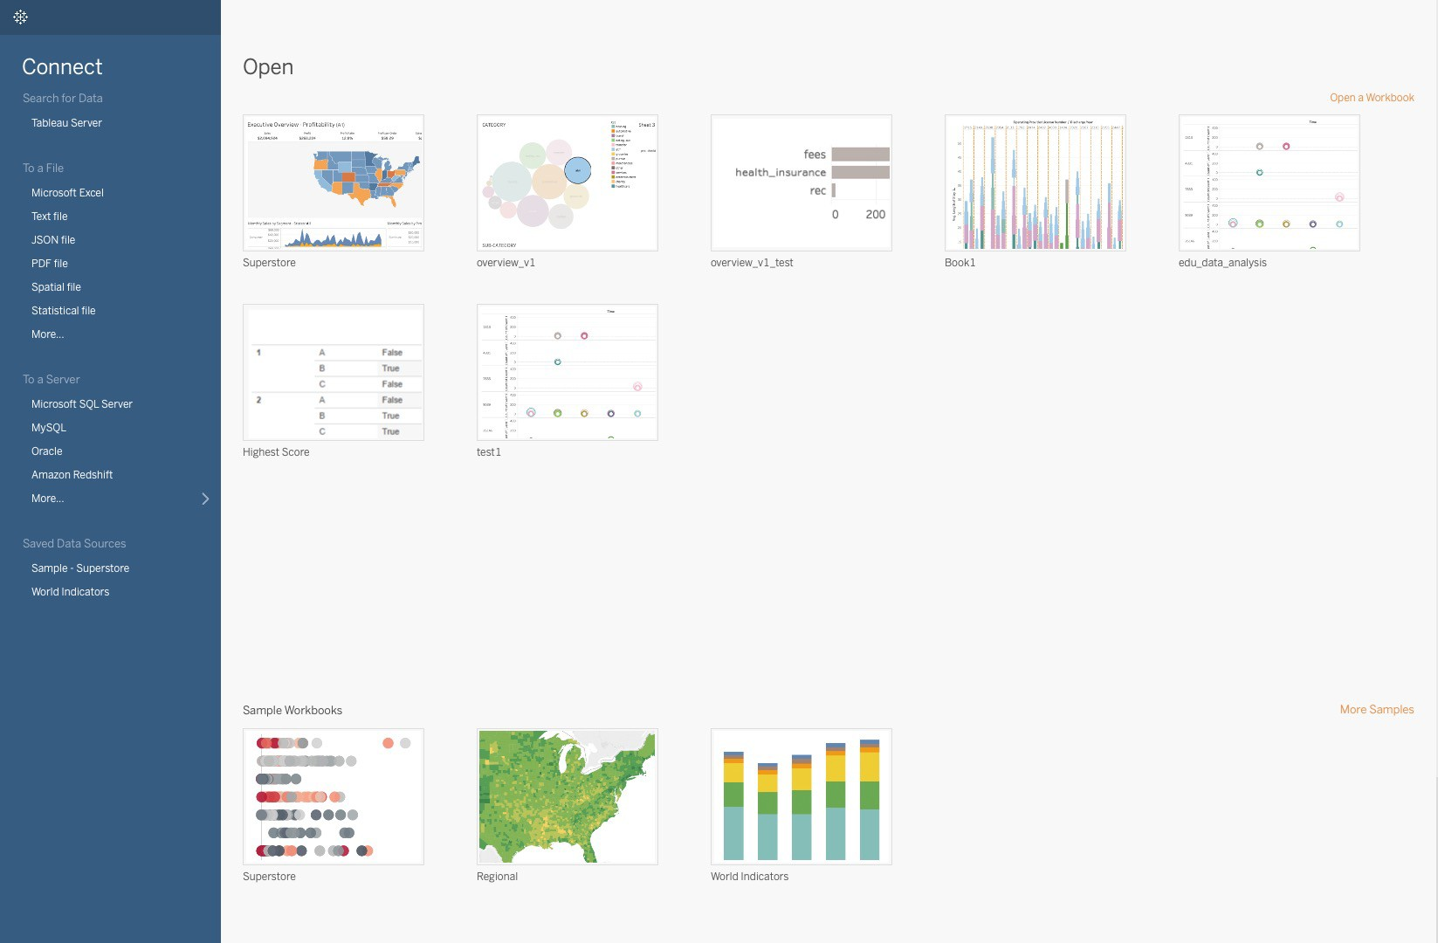
Connect

Slide 10
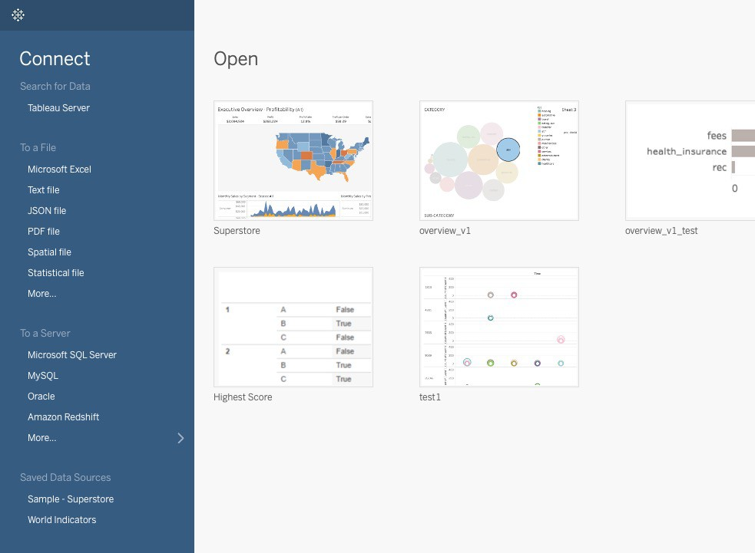
Connect

Slide 11
Data Sources Types
Spreadsheets
Relational Databases
Cloud Data
Other Sources
Excel or csv file
MySQL or Oracle
AWS or Microsoft Azure
Spatial Files or R

Slide 12
Data Field
A field, also known as a column, is a single piece of information from a record in a data set.
Qualitative Field (Dimensions)
Describes or Categorizes Data
What, when or who
Slices the quantitative data
Quantitative Field (Measures)
Numerical Data
Provides measurement for qualitative category
Can be used in calculations

Slide 13
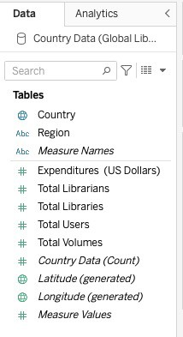
Data Field

Slide 14
Data Field
Dimensions

Slide 15
Data Field
Dimensions
Measures

Slide 16
Data Field
Dimensions
Measures
By default, aggregated by SUM
Can be aggregated as average, median, count, or count distinct.

Slide 17
Data Field
Dimensions
Break down the aggregated total into smaller totals by category.
Measures
By default, aggregated by SUM
Can be aggregated as average, median, count, or count distinct.

Slide 18






Data Types
Text or String Values
Discrete Date/Time
Discrete Date
Geographic field - State or Zip Code
Continuous Numeric Value
Calculated Field

Slide 19

Chart Types
Line — View trends in data over time.
Bar — Compare data across categories.
Heat Map — Show the relationship between two factors.
Examples: Stock price change over a five-year period or website page views during a month.
Examples: Volume of shirts in different sizes, or percent of spending by department.
Examples: Segment analysis of target market, or sales leads by individual rep.

Slide 20
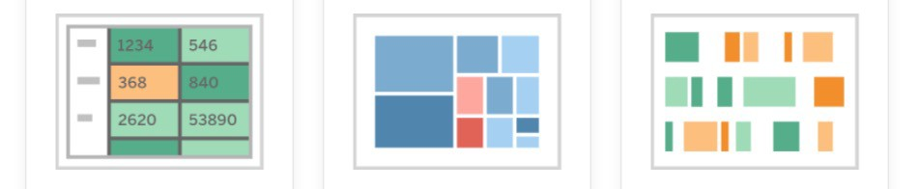
Chart Types
Highlight Table — Shows detailed information on heat maps.
Treemap — Show hierarchical data as a proportion of a whole.
Gantt — Show duration over time.
Examples: Project timeline, duration of a machine’s use, availability of players on a team.
Examples: Storage usage across computer machines, comparing fiscal budgets between years.
Examples: The percent of a market for different segments, or sales numbers in
a region.

Slide 21
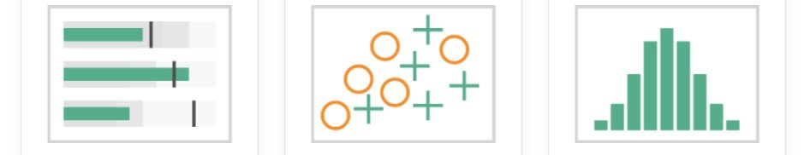
Chart Types
Bullet — Evaluate performance of a metric against a goal.
Scatterplot — Investigate relationships between quantitative values.
Histogram — Understand the distribution of your data.
Examples: Sales quota assessment, performan ce spectrum (great/good/poor).
Examples: Male versus female likelihood of having lung cancer at different ages
Examples: Number of customers by company size, student performance on an exam, frequency of a product defect.

Slide 22
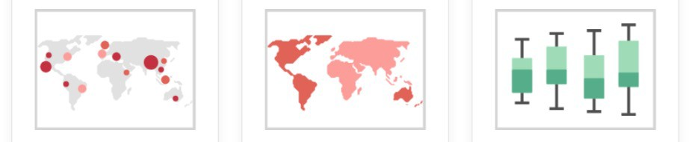
Chart Types
Symbol maps — Use for totals rather than rates. Be careful, as small differences will be hard to see.
Area maps — Use for rates rather than totals. Use sensible base geography.
Box-and-Whisker — Show the distribution of a set of a data.
Examples: Understand ing your data briefly, seeing how data is skewed towards one end, identifying outliers in your data.
Examples: Rates of internet-usage in certain geographies, house prices in different neighborhoods.
Examples: Number of customers in different geographies.

Slide 23
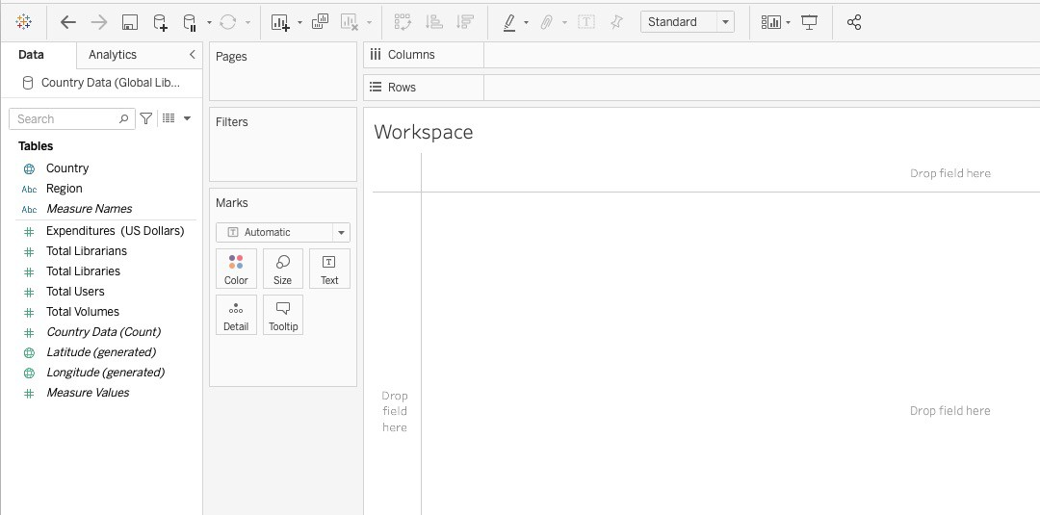
Tableau Workspace

Slide 24
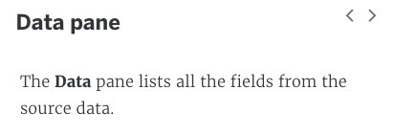
Tableau Workspace

Slide 25
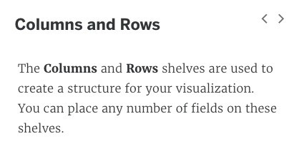
Tableau Workspace

Slide 26
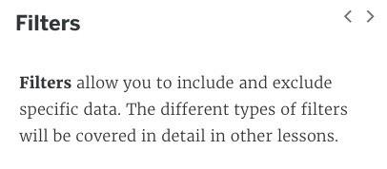
Tableau Workspace

Slide 27
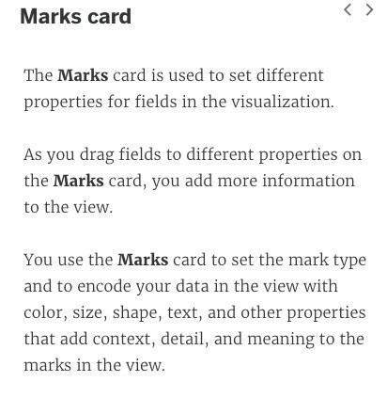
Tableau Workspace

Slide 28
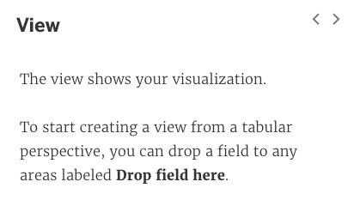
Tableau Workspace

Slide 29
Visualization

Slide 30
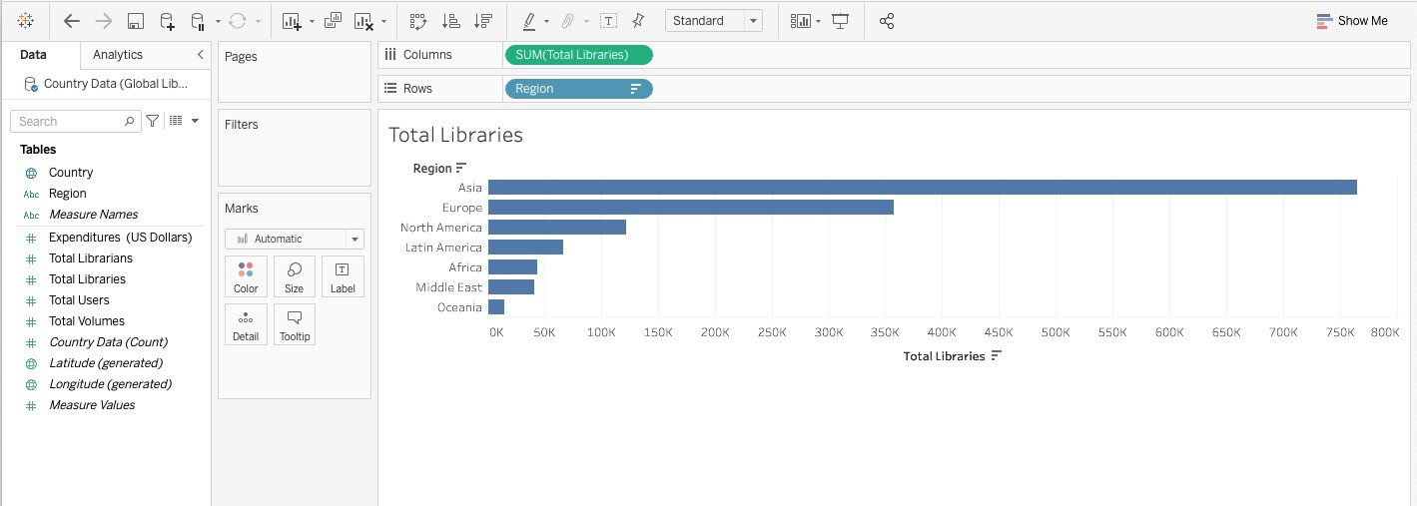
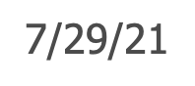
Visualization

Slide 31
Visualization

Slide 32
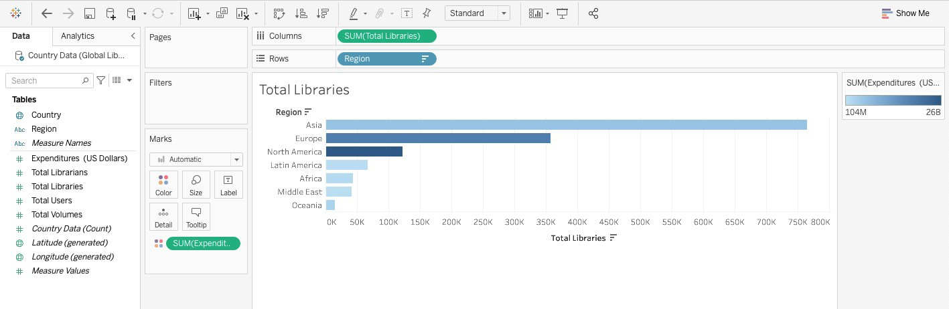
Visualization

Slide 33
Visualization

Slide 34
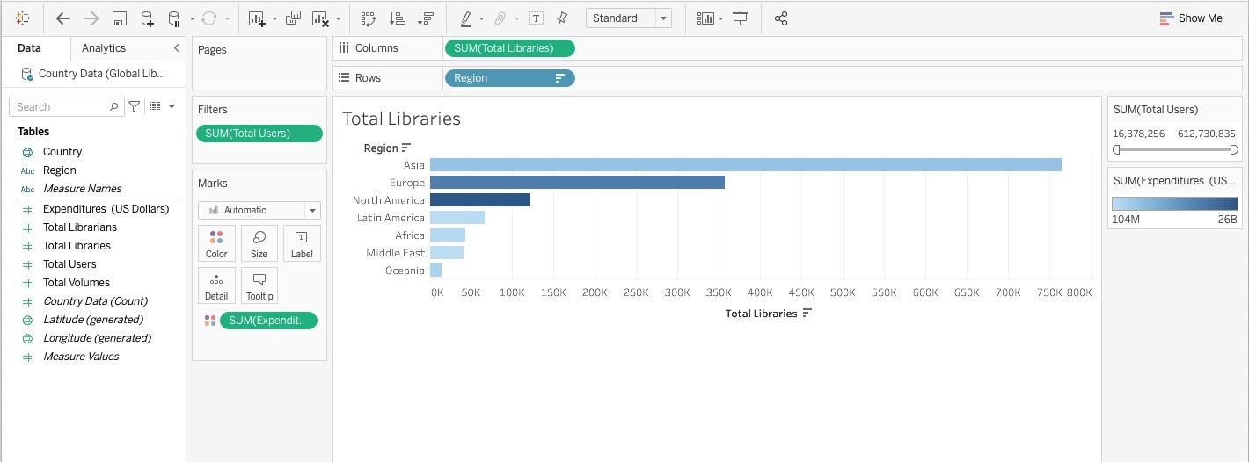
Visualization

Slide 35
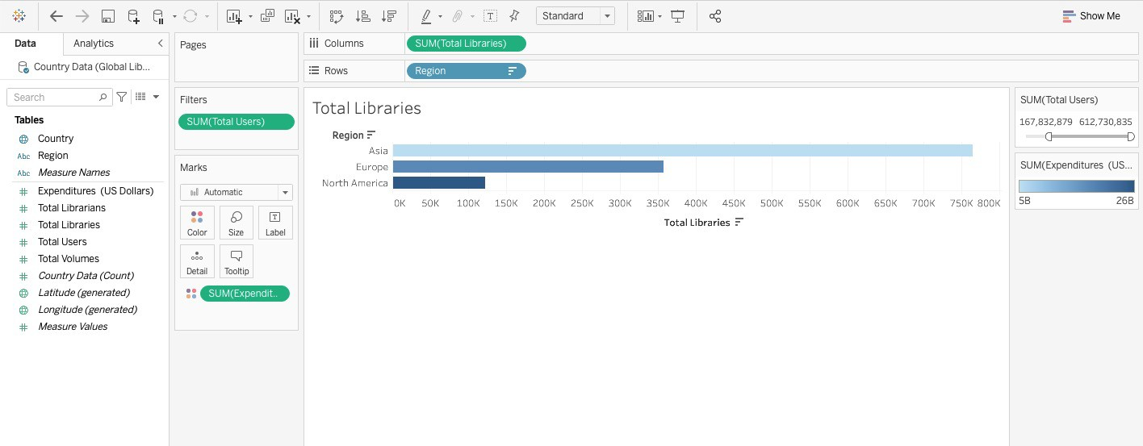
Visualization

Slide 36
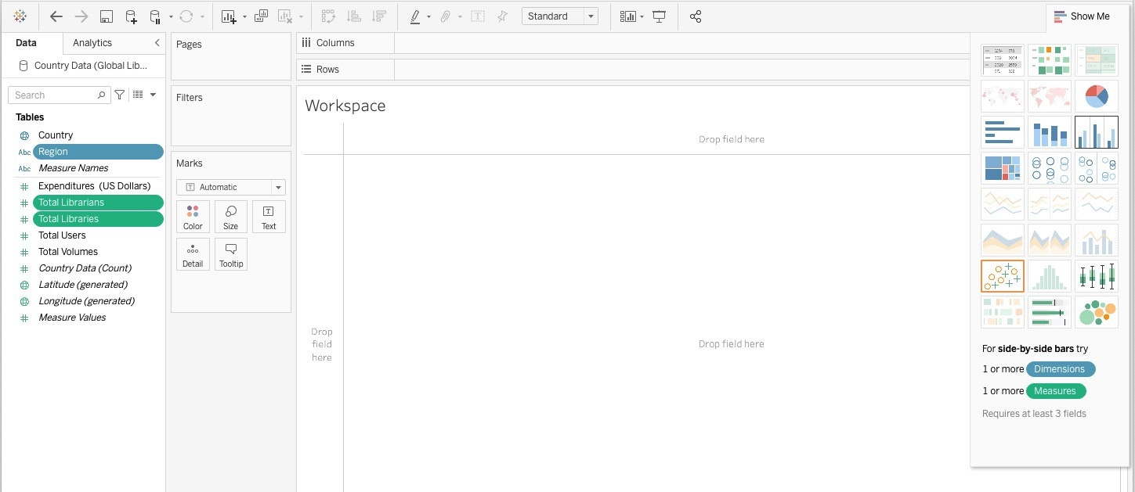
Visualization

Slide 37
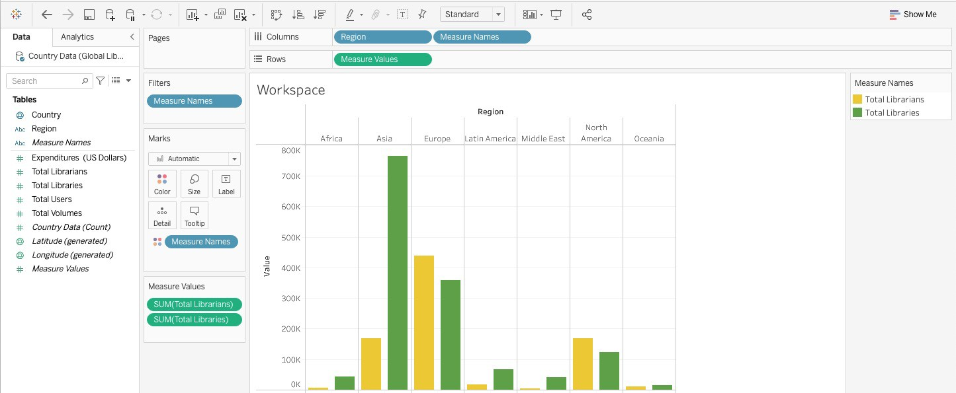
Visualization

Slide 38
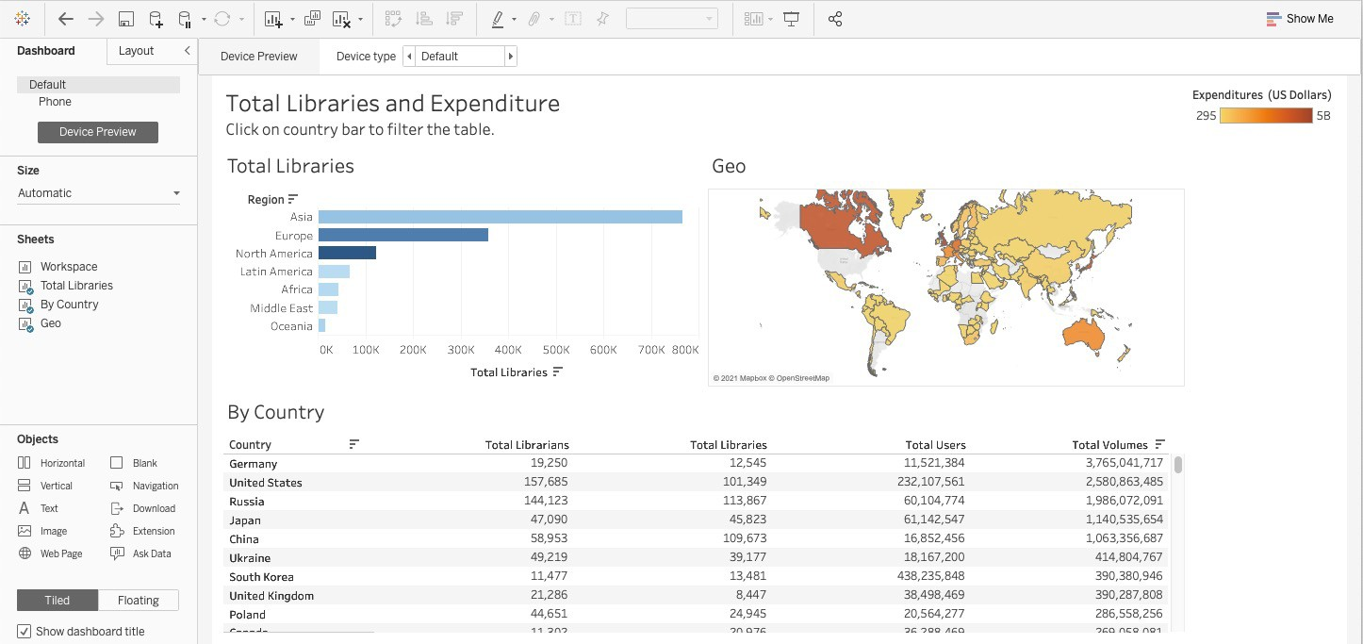
Dashboard

Slide 39
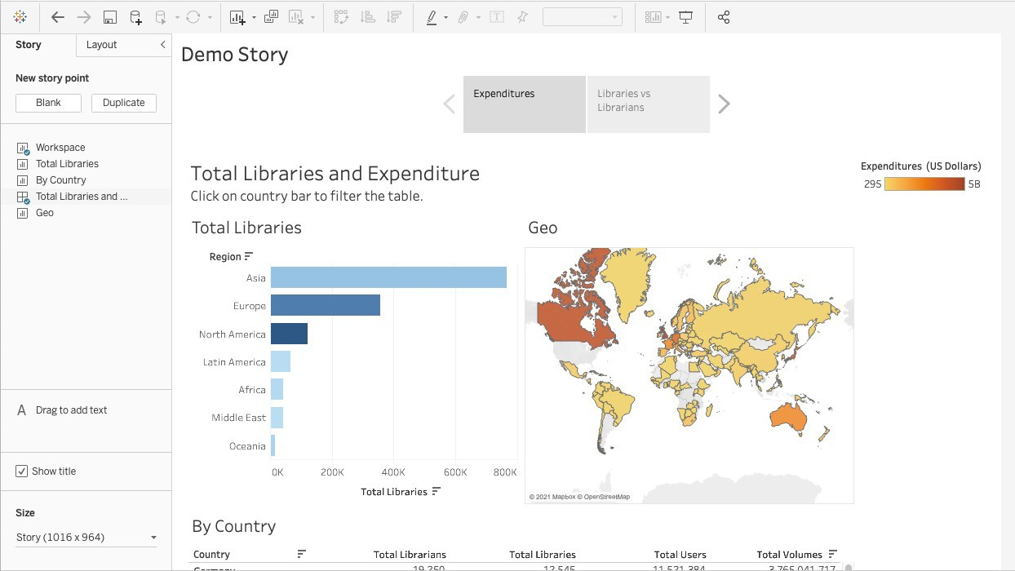
Story

Slide 40
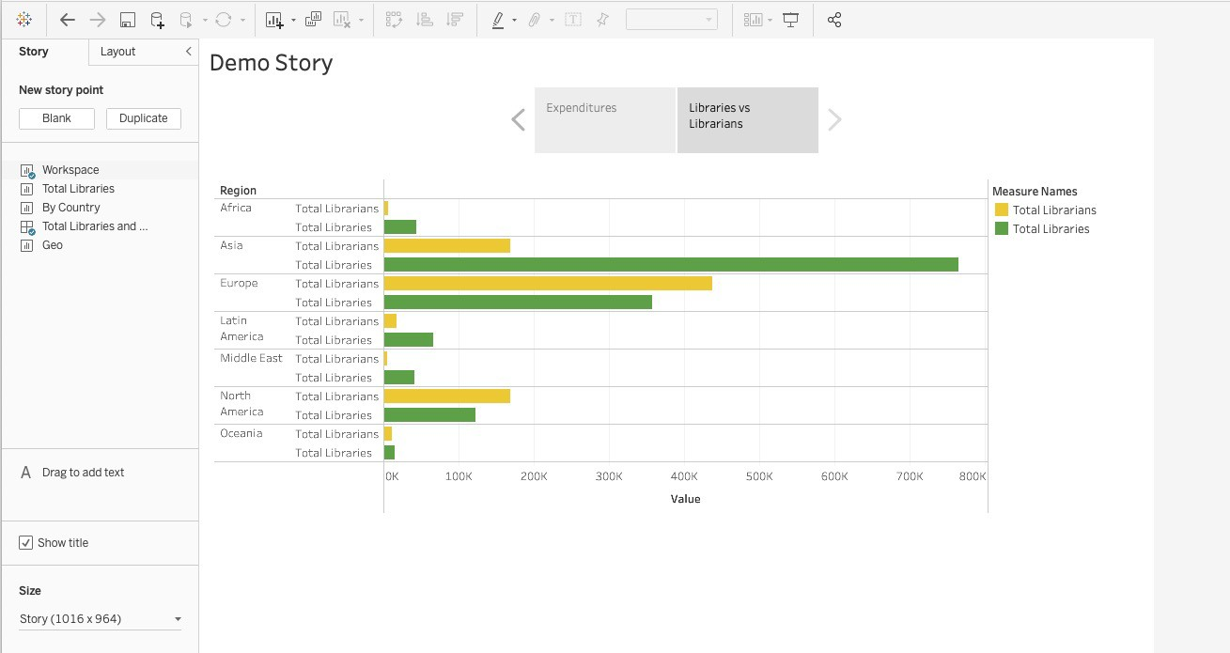
Story

Slide 41
Share
Saved File
.twb or .twbx
Publish to Tableau Server (Secure)
Publish to Tableau Public (Unsecure)

Slide 42

The power of communication

Slide 43

Overcoming nervousness​
Confidence-building strategies

Slide 44
Engaging the audience
Make eye contact with your audience to create a sense of intimacy and involvement
Weave relatable stories into your presentation using narratives that make your message memorable and impactful
Encourage questions and provide thoughtful responses to enhance audience participation
Use live polls or surveys to gather audience opinions, promoting engagement and making sure the audience feel involved

Slide 45
Selecting visual aids
Enhancing your presentation

Slide 46
Effective delivery techniques​
Voice modulation is a powerful tool in public speaking. It involves varying pitch, tone, and volume to convey emotion, emphasize points, and maintain interest:
Pitch variation​
Tone inflection​
Volume control
Effective body language enhances your message, making it more impactful and memorable:
Meaningful eye contact
Purposeful gestures
Maintain good posture
Control your expressions

Slide 47
Navigating Q&A sessions
Know your material in advance​
Anticipate common questions​
Rehearse your responses
Maintaining composure during the Q&A session is essential for projecting confidence and authority. Consider the following tips for staying composed:​
Stay calm​
Actively listen​
Pause and reflect​
Maintain eye contact

Slide 48

Speaking impact​
Your ability to communicate effectively will leave a lasting impact on your audience​
Effectively communicating involves not only delivering a message but also resonating with the experiences, values, and emotions of those listening

Slide 49
Dynamic delivery​
Learn to infuse energy into your delivery to leave a lasting impression​
One of the goals of effective communication is to motivate your audience
Metric​ | Measurement​ | Target​ | Actual​
Audience attendance​ | # of attendees​ | 150​ | 120​
Engagement duration​ | Minutes​ | 60​ | 75​
Q&A interaction​ | # of questions​ | 10​ | 15​
Positive feedback​ | Percentage (%)​ | 90​ | 95​

Slide 50
Final tips & takeaways​
Consistent rehearsal​
Practice makes perfect, so strengthen your familiarity with the presentation​
Refine delivery style​
Pacing, tone, and emphasis​
Timing and transitions​
Aim for seamless, professional delivery​
Practice audience
Enlist colleagues to listen & provide feedback​
Seek feedback​
Reflect on performance​
Explore new techniques​
Set personal goals​
Iterate and adapt

Slide 51
Speaking engagement metrics​
Impact factor​ | Measurement​ | Target​ | Achieved​
Audience interaction​ | Percentage (%)​ | 85​ | 88​
Knowledge retention​ | Percentage (%)​ | 75​ | 80​
Post-presentation surveys​ | Average rating​ | 4.2​ | 4.5​
Referral rate​ | Percentage (%)​ | 10​ | 12​

Slide 52
THANK YOU
Brita Tamm​
502-555-0152​
brita@firstupconsultants.com​
www.firstupconsultants.com

